Slide 1
HYPERLEDGER INDY: ENABLING DECENTRALIZED DIGITAL IDENTITIES
SECURE, PRIVATE, AND TRUSTED IDENTITY MANAGEMENT FOR THE MODERN ERA
Presented By:
Rahul Batham

Slide 2


Hyperledger Indy is a blockchain framework that provides tools and libraries for creating digital identities. It's designed to be decentralized and interoperable with other blockchains.
02

Slide 3
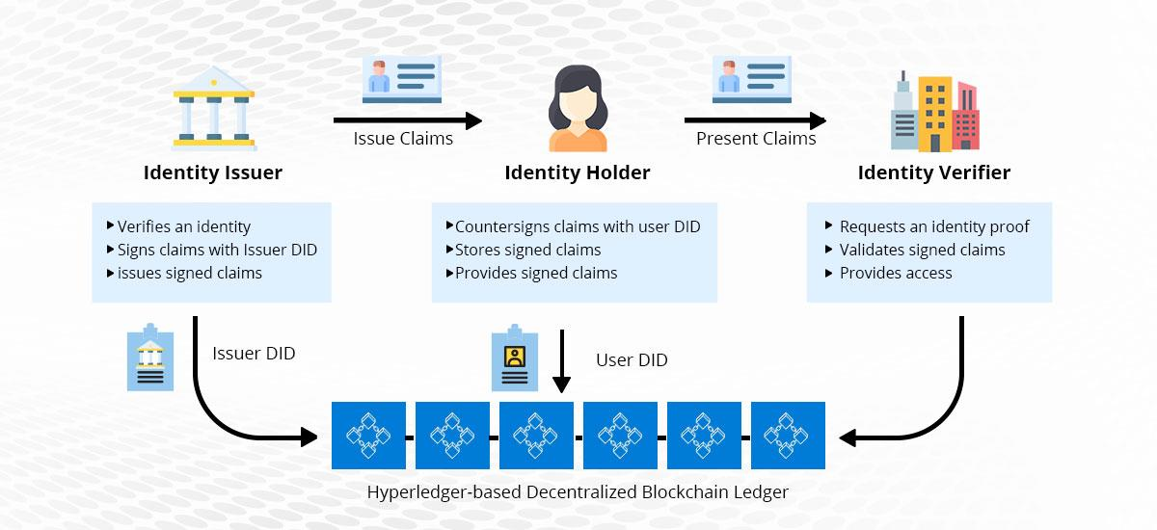
EXAMPLE: TRUSTED CREDENTIAL VERIFICATION WITH HYPERLEDGER INDY
In this example, a graduate receives a digital diploma from their university as a Verifiable Credential using Hyperledger Indy. When applying for a job, the graduate shares this credential with a potential employer, who can verify its authenticity in real-time through Indy’s decentralized ledger. This streamlined process enhances trust, security, and efficiency, reducing the risk of credential fraud and eliminating the need for paper-based verification.
03

Slide 4
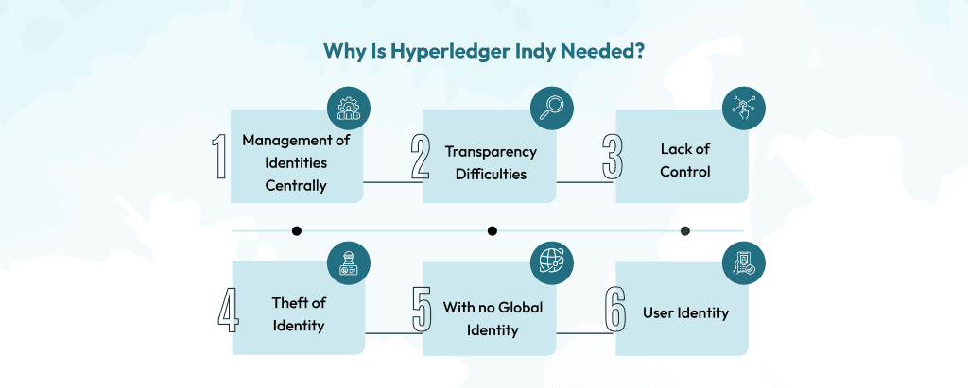
WHY HYPERLEDGER INDY ?
BORCELLE

Slide 5
KEY FEATURES OF HYPERLEDGER INDY
BORCELLE
•Public & Permissioned Blockchain.
•Custom built for Decentralized Identity.
•DIDs (Decentralized Identifiers) that are globally unique and resolvable.
•Pairwise Identifiers create secure, 1:1 relationships between any two entities.
•Support for Zero Knowledge Proofs (ZKP) which prove data in a set of Claims.
05

Slide 6
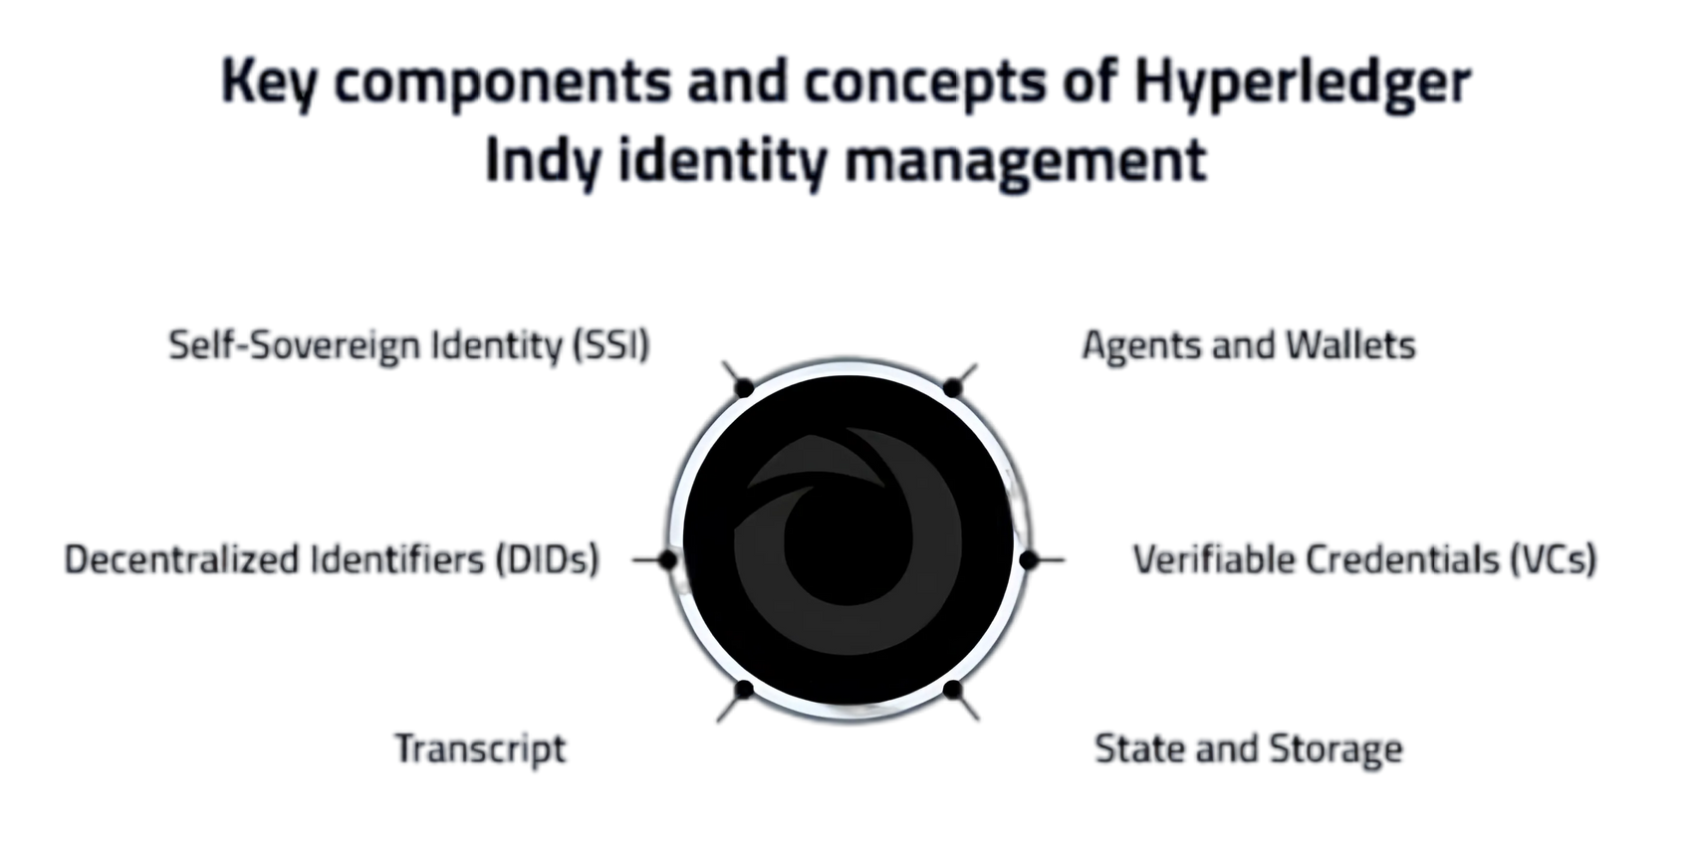
MODULAR ARCHITECTURE OF HYPERLEDGER INDY
IDENTITY WALLET
DECENTRALIZED IDENTIFIERS (DIDS) & DID METHOD
Secure app for managing digital Identities
Stores DIDs and credentials.
Protocol for creating unique, decentralized identifiers.
Represents users or entities securely on the network.

Slide 7
MODULAR ARCHITECTURE OF HYPERLEDGER INDY
DID RESOLVER
VERIFIABLE CREDENTIALS (VCS)
Resolves DIDs to access associated identity information.
Enables seamless identity verification.
Digital representations of real-world credentials (e.g., degrees, licenses).
Verifiable and issued by trusted authorities

Slide 8
MODULAR ARCHITECTURE OF HYPERLEDGER INDY
VC ISSUER, HOLDER, AND VERIFIER
LEDGER
Issuer: Issues credentials.
Holder: Stores credentials securely.
Verifier: Checks authenticity of credentials.
Tamper-proof, blockchain-based database.
Stores identity data and transaction history securely.

Slide 9
MODULAR ARCHITECTURE OF HYPERLEDGER INDY
NODES
AGENT
Full Nodes: Validate network transactions.
Master Nodes: Aid in governance and consensus.
General Nodes: Support blockchain operations.
Acts on behalf of users or organizations.
Ranges from simple apps to cloud-based services

Slide 10
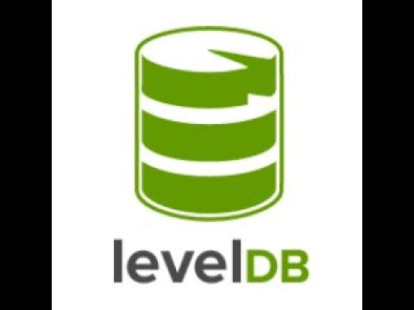
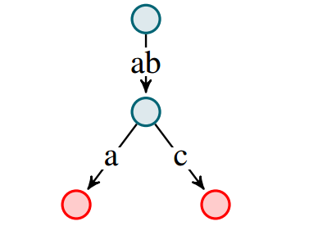
MODULAR ARCHITECTURE OF HYPERLEDGER INDY
STATE AND STORAGE
Patricia Trie: Manages fast lookups and data integrity.
LevelDB: Provides efficient, ordered key-value storage.
PATRICIA TRIE

Slide 11
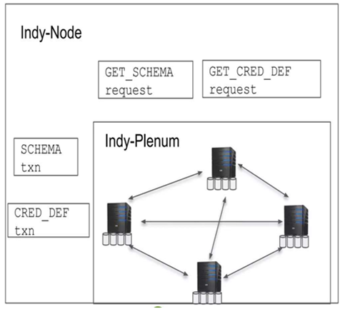
COMPONENTS OF HYPERLEDGER INDY
Indy-node : Provides core functionality to run nodes a s validators or observers.
Indy-plenum:Handles consensus, cryptography, and ledger operations.
DISTRIBUTED LEDGER
07

Slide 12
COMPONENTS OF HYPERLEDGER INDY
CLIENT TOOLS
Indy VDR ledger interface/client: New ledger interface/client for secure decentralized identity management.
Aries Askar : Secure storage library for managing Decentralized Identifiers (DIDs) and credentials.
Hyperledger AnonCreds: Verifiable Credentials implementation.
Indy CLI: Command-line tool for executing Indy operations and managing identities.
07

Slide 13
COMPONENTS OF HYPERLEDGER INDY
ARIES FRAMEWORKS
•Aries Cloud Agent Python: Python framework for building secure identity management applications.
•Credo:JavaScript framework for creating web and mobile identity agents.
•Aries VCX: Framework for managing verifiable credentials in identity agents.
07

Slide 14
COMPONENTS OF HYPERLEDGER INDY
SHARED COMPONENTS
•Indy-hipe:Supports Hyperledger Indy Improvement Proposals.
•Indy BLS Signatures: Provides enhanced cryptographic security.
Hyperledger AnonCreds CL Signatures: Manages privacy-preserving credentials
07

Slide 15
INDY PROTOCOLS
Indy-Node Protocol
Manages node operations and communication.
Ensures network consensus (e.g., Sovrin Consensus) and transaction handling.
Ledger Operations
Controls data interactions on the ledger.
Write (create DIDs, credentials), Read (retrieve data), Update.
Interoperability Protocols
Integrates with other systems and blockchain networks.
Facilitates cross-platform data exchange.
Decentralized Identifiers (DIDs)
Provides unique, decentralized entity identifiers.
Supports creation, management, and resolution of DIDs.

Slide 16
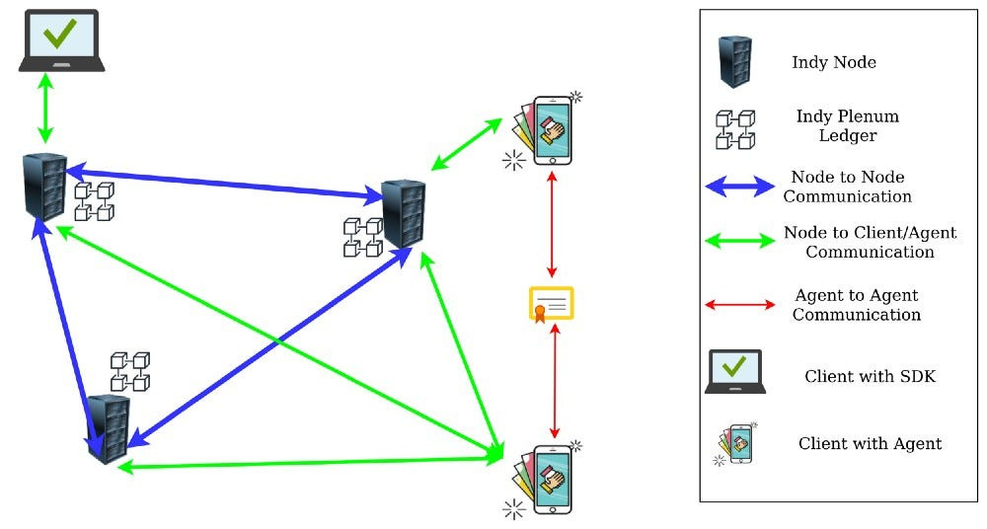
INDY PROTOCOLS
Verifiable Credentials
Manages digital credential issuance and verification.
Enables secure sharing and validation by trusted entities
Cryptographic Operations
Secures identity data with encryption and digital signatures.
Supports key management for transaction security.

Slide 17
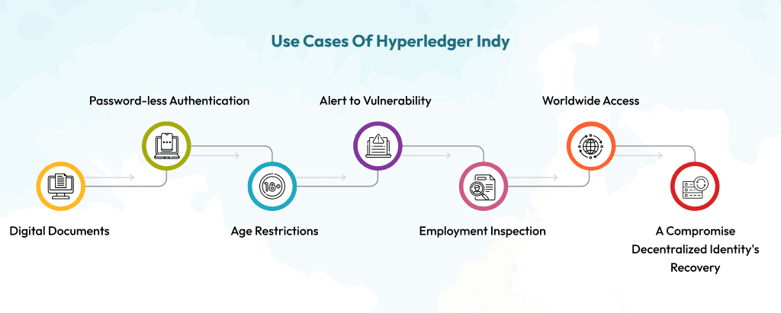
HYPERLEDGER INDY USE CASES AND REAL-WORLD APPLICATIONS

Slide 18
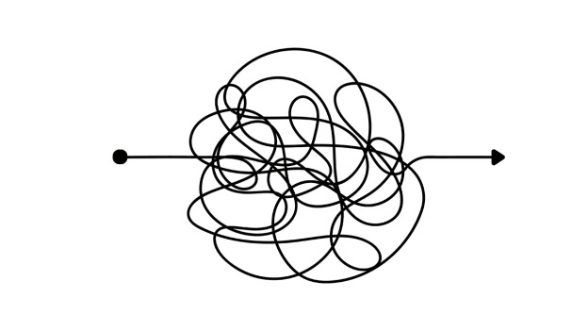




LIMITATION OF HYPERLEDGER INDY
Complexity
Adoptation
Interoperability
Scalability
Data Storage

Slide 19



Hyperledger Aries is an open-source framework and toolkit within the Hyperledger project that focuses on enabling interoperable, decentralized identity solutions. It provides the tools and protocols necessary for creating, exchanging, and verifying digital credentials in a secure and privacy-preserving manner.
02

Slide 20
KEY FEATURES
Interoperability: Works across multiple blockchain networks.
Decentralized Identity: Empowers users to own their identity data.
Secure Messaging: Built-in encrypted communication protocols.
Reusability: Compatible with standards like DIDComm (Decentralized Identity Communication).

Slide 21
ARIES AGENT FRAMEWORKS
Developers who want to solve business problems should start with an Aries agent framework.
Aries Cloud Agent - Python (ACA-Py) is suitable for all non-mobile agent applications and has production deployments.
Aries Framework - .NET -can be used for building mobile (via Xamarin) and server-side agents and has production deployments.
Aries Static Agent - Python is a configurable agent that does not use persistent storage.
02

Slide 22
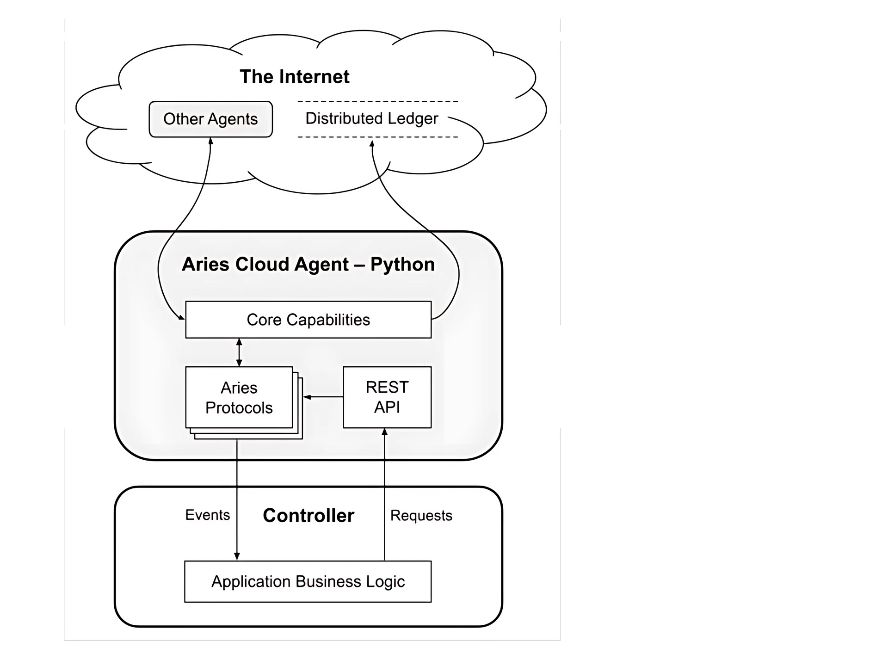
ARIES ARCHITECTURE
DIDComm Messaging Layer: Handles secure, encrypted communication between agents using the Aries protocol.
.
Secure Wallet: Stores DIDs, credentials, and cryptographic keys safely for identity management.
REST APIs: Provides endpoints to interact with ACA-Py for credential issuance, proof presentation, and more.

Slide 23
ARIES ARCHITECTURE
Protocol Handlers: Manages workflows like connection establishment, credential exchange, and proof verification.
Ledger Interface: Connects to a blockchain (e.g., Hyperledger Indy) to store and retrieve public data like schemas and DIDs.

Slide 24





INTEGRATION WITH HYPERLEDGER INDY
ACA-PY AGENT
ACA-Py is tightly integrated with Hyperledger Indy for ledger operations:
Stores schemas and credential definitions.
Resolves public DIDs.
Provides Revocation Support via Revocation Registries.
DIDComm Layer
Protocol Handlers
Wallet
API
Transport Layer
Hyperledger Indy Ledger
Applications
(eg-Frontend )

Slide 25
BENEFITS
User-Controlled Data: Individuals have complete control over their digital identity.
Enhanced Privacy: Only share required credentials, reducing data exposure.
Interoperability: Works seamlessly with multiple blockchain ecosystems.
Trustworthy Transactions: Cryptographic methods ensure data integrity.

Slide 26
LIMITATIONS
Scalability: Some limitations with high-volume operations.
Complexity: Initial setup and implementation can be challenging.
Dependency on Standards: Requires universal adoption of protocols for full effectiveness.
Mobile use: Some say that Hyperledger Aries doesn't adapt well to mobile use.
Revocation: Some say that the current revocation is insufficient for business needs.

Slide 27
THANK YOU

